Slide 1
Progress of Accreditation in Health Service Sector, Way Forward
Dr. K A C Wickramaratne
Specialist in Haematology
Senior Lecturer, Department of Pathology, Faculty o Medicine, University of Ruhuna

Slide 2
Progress of Accreditation in Health Service Sector: the way forward
Wickramaratne K.A.C

Slide 3
“Delivering a Safer World”
Patient safety
Employee safety
Environment Safety
Have we assured these through Accreditation?

Slide 4
Achievements in SL
Started and continued as a volunteer process
How safety and quality improved - Number of laboratories
Assessor work force and educating assessors
APLAC ILAC MRA
Awareness on accreditation Initiatives from Professional Colleges
National Guidelines Development
MoH commitment and future

Slide 5
Some stories from the past
Use of polythene bags to fill needles
A patient with heart failure survives from serious – near fatal heart failure following blood transfusion. His pre transfusion Hb was an error !
A laboratory employee mistakenly drank a chemical thinking it is water !
A patient was admitted almost in shock with dengue fever at 5 pm.
Results generated at a laboratory at 9 a.m not informed as there was no system
A patient diagnosed with active TB has AFB negative report issued previously

Slide 6
Today in accredited laboratories we witness
Appropriate clinical waste management system
Employee vaccination and verification of immunization status in place
Critical and alert value reporting
Sample acceptance and rejection criteria – meticulous attention
No water – food served inside laboratories
Errors detected before results are released – vigilant QC and QM
Emergency eyewash stations
Employee training on safety, PPE
MSD sheets

Slide 7
Assessor workforce and educating assessors
Dramatically increased including all sub specialties
Professional Colleges – College of Haematologists, Microbiologists, Chemical Pathologists, Histopathologists
Back log of training
Need re training and more WS to cover issues related to raising NCR and how to perform audits – “not to kill the process – but to ensure compliance ”
ISO 15189: 2012 beyond such as POCT

Slide 8
Initiatives of Professional Colleges
Island wide awareness programs/ training sessions/ WS and seminars conducted.
Included accreditation of medical laboratories in to BSc MLS curriculum
Quality Improvement Initiatives all over the country – both in private and public sector
National EQA programs and individual units with IQC programs – funded by MoH
Define quality requirements of supplies – eg: PT reagent ISI value/ D Dimer test
MoH with Colleges ensure quality equipment, reagents and consumables are purchased – meticulous attention on “quality of the product”

Slide 9
National Guidelines
SLAB sub committees
Individual professional Colleges
Implementation of National Guidelines through MoH

Slide 10
MoH commitment
Hospital Accreditation Initiative
Recognition of ISO 15189 as level five – requirement
Defined tests and services availability at each level of healthcare institution hierarchy
QA council/ committees initiatives
Procurement process based on quality standards – to ensure patient safety

Slide 11
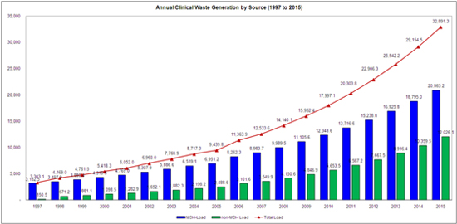
Anything missing ?
Workforce training
Phlebotomists - ? official registration
Sample collection centres - ? How to improve compliance
POCT – simple capillary BS to ABG analysis – POCT management program with accreditation
Defining qualifications and competencies required at different test levels
Accreditation of medical clinical laboratories outside Colombo
Island wide Clinical Waste disposal

Slide 12
Way forward
MoH contribution and Quality initiatives
National policies on quality and safety
Changing Healthcare Environment from high out put burden to quality output
Challenges – how to assure influx of quality products ?
Harmonization and standardization – same laboratory with three different analyser brands for same test !
To assure you can get it done from any laboratory – we can rely on !!!!

Slide 13
EQA analysis
✓
?
?

Slide 14
Way forward ……….
During last nine years accreditation gained recognition and demand in and around Colombo
How to move in to the rest of the Country?
Why is it slow ?
Not perceived as a requirement – GLP “social responsibility ignored ” ?
Registration by MoH – does it give “immunity” that we are approved ?
Is it considered a “strain - burden” – both work to be done and money ?
What message is given to smaller laboratories ?

Slide 15
Questions and Answers

Slide 16
Thank you

